Slide 1
Lessons Learned From Agile Quality Assurance In Scrum

Slide 2
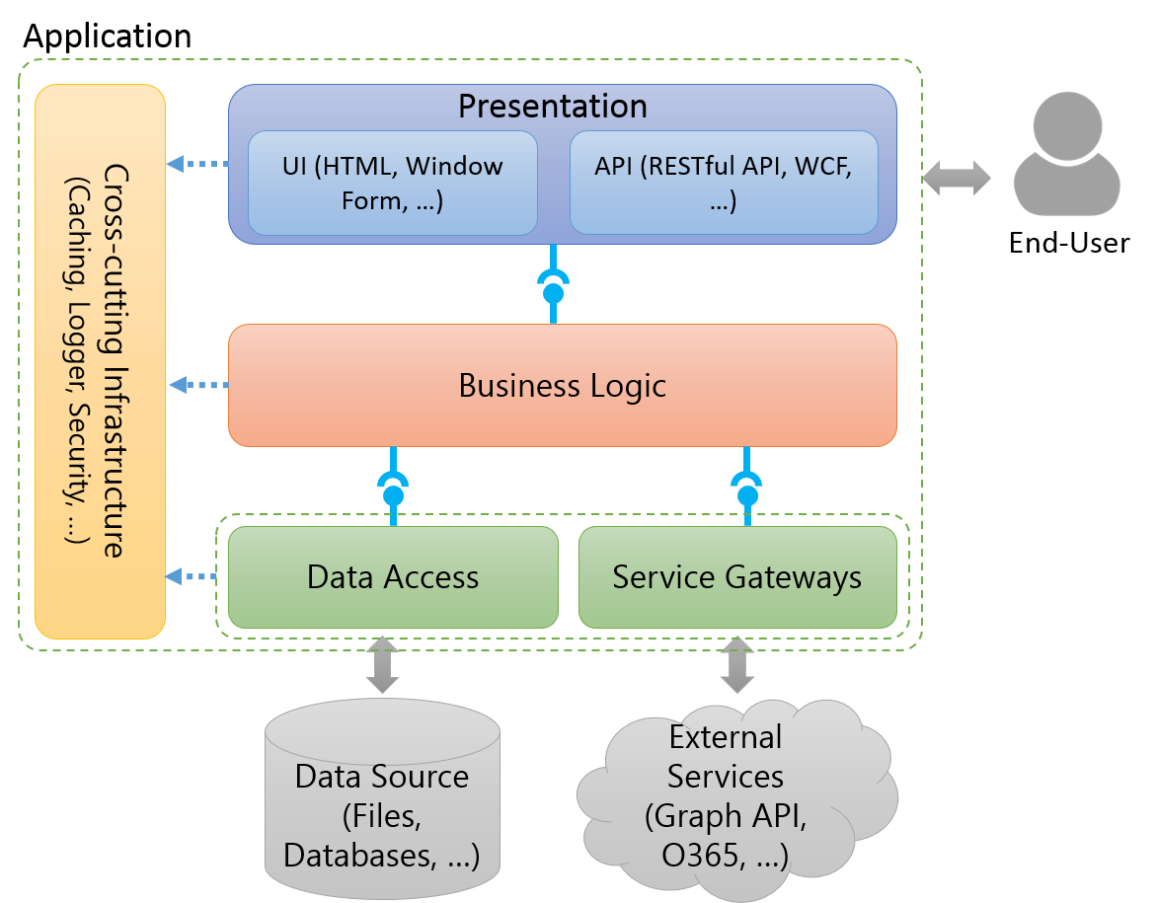
The conceptual structure of an application to software testing
Notes:
To talk something about the conceptual structure of an application to show to audiences the structure which is applied in almost applications.

Slide 3
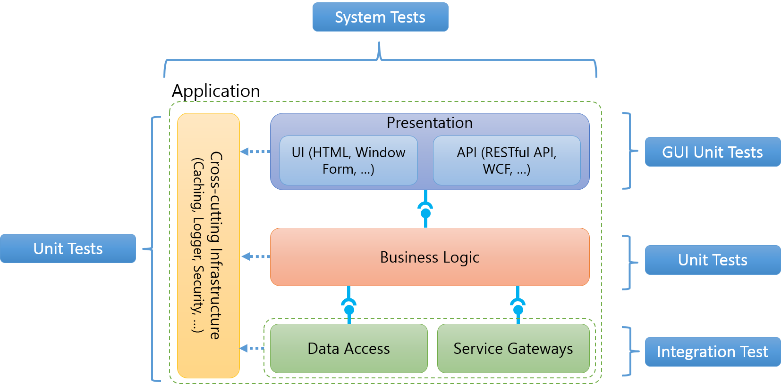
The conceptual structure of an application to software testing
Notes:
To indicate what aspects of an application are covered which types of test (Ex: Business Logic is covered by unit tests.)

Slide 4

Application
Cross-cutting Infrastructure
(Caching, Logger, Security, …)
Presentation
UI (HTML, Window Form, …)
API (RESTful API, WCF, …)
End-User
Business Logic
Data Access
Service Gateways
Data Source (Files, Databases, …)
External Services (Graph API, O365, …)

Slide 5
System Tests
Application
Cross-cutting Infrastructure
(Caching, Logger, Security, …)
Presentation
UI (HTML, Window Form, …)
API (RESTful API, WCF, …)
GUI Unit Tests
Unit Tests
Business Logic
Unit Tests
Data Access
Service Gateways
Integration Test
Notes:
http://blogs.msdn.com/b/jmeier/archive/2008/11/24/application-architecture-diagrams-added-to-codeplex.aspx

Slide 6




Client
Browser
Web Server
Business Entity
Presentation
Cross-cutting Infrastructure
UI (MVC, Window Form, …)
API (RESTful API, WCF, …)
Configuration
Business Logic
Logging
Utilities
Service Gateways
Other Common Blocks
Database
(Cassandra, MongoDb, …)
Queue
(Service Bus, RabbitMQ, …)
Cloud API (Facebook Graph API, Twitter API, …)
Memcache (Redis, MemcacheDB, …)
Notes:
http://blogs.msdn.com/b/jmeier/archive/2008/11/24/application-architecture-diagrams-added-to-codeplex.aspx

Slide 7



Client
Browsers
Service Consumers
Users
Share Types
Web (MVC, Web API, …)
Window Form
Cross-cutting Infrastructure
IoC
Application Services
Adapter
Business Level 1
Business Level 1
Logging
Enum
Utilities
Business Entity
Service Gateways
Other Common Blocks
Database
(MySQL, SQL Server, …)
Queue
(Service Bus, RabbitMQ, …)
Cloud API (Facebook Graph API, Twitter API, …)
Cache (Redis, MemcacheDB, …)

Slide 8
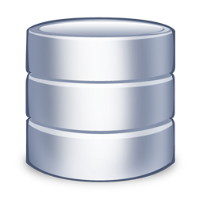
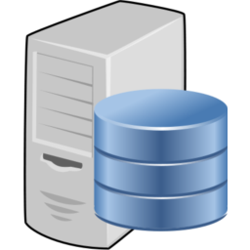

Source Repository
Build Server
Development Machine

